Slide 1

WHATS your accent ?
Jules ALBIN

Slide 2
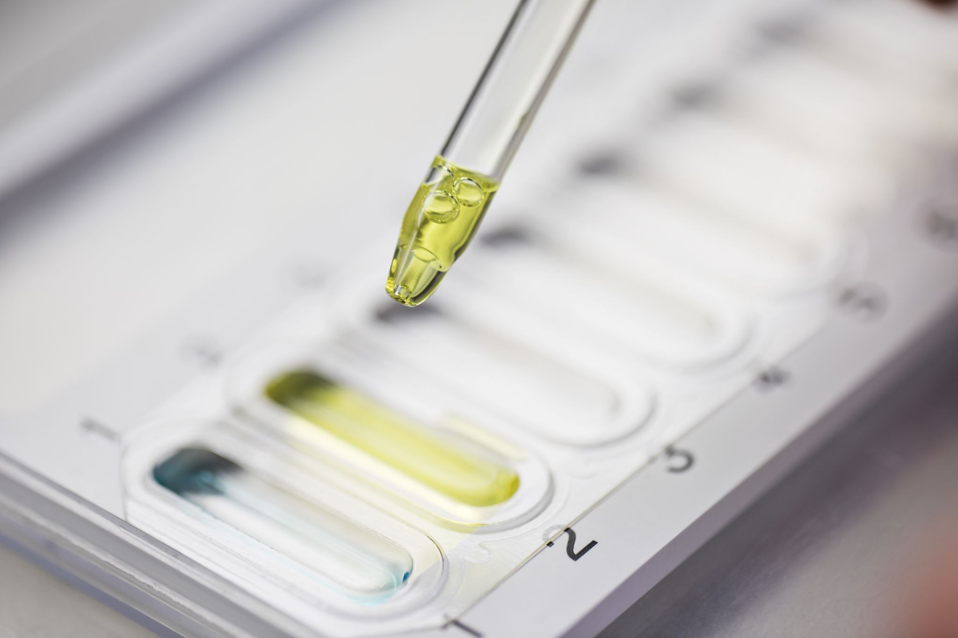
TABle of content
Introduction
Planning
Data Gathering
Data Wrangling
Databases
API
Exploratory Data Analysis
Visualisation
Machine Learning
Challenges

Slide 3
INTRODUCTION
Context
Business cases
Objectives

Slide 4
There is ALWAYS A Need for:
Context
Improving communication
Addressing Cultural differences
Circumventing barrier languages
4

Slide 5
Objectives
Investigate the relationships between native language and English accent.
predict native language based on the accent.
5

Slide 6
Imagination is the limit !
Customer Service and Support
Language Learning Platforms
Market Research and Targeted Advertising
Business cases
6

Slide 7

planning

Slide 8
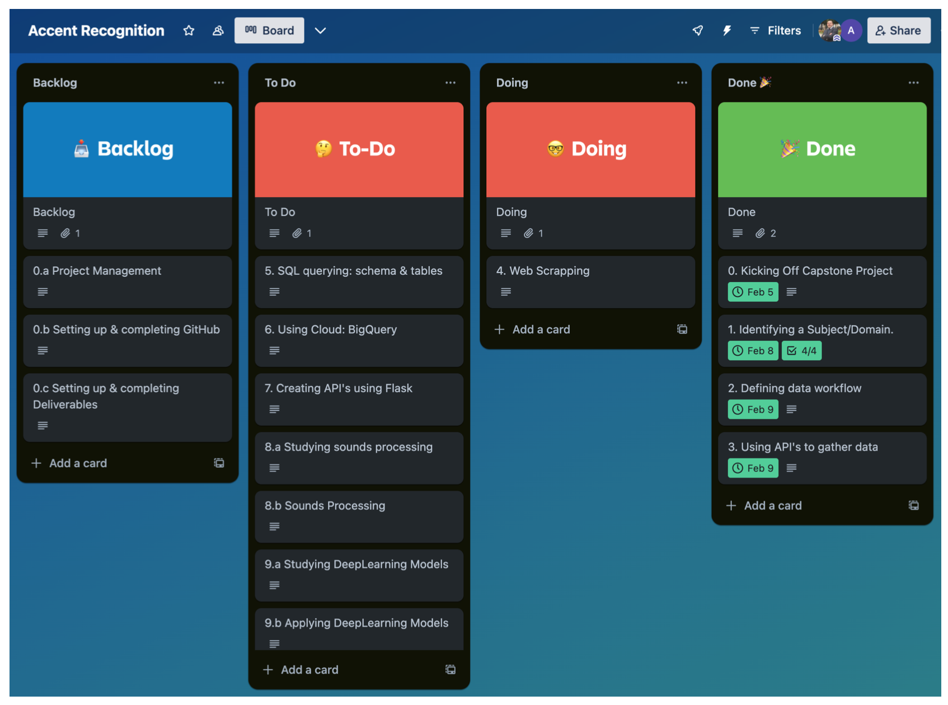
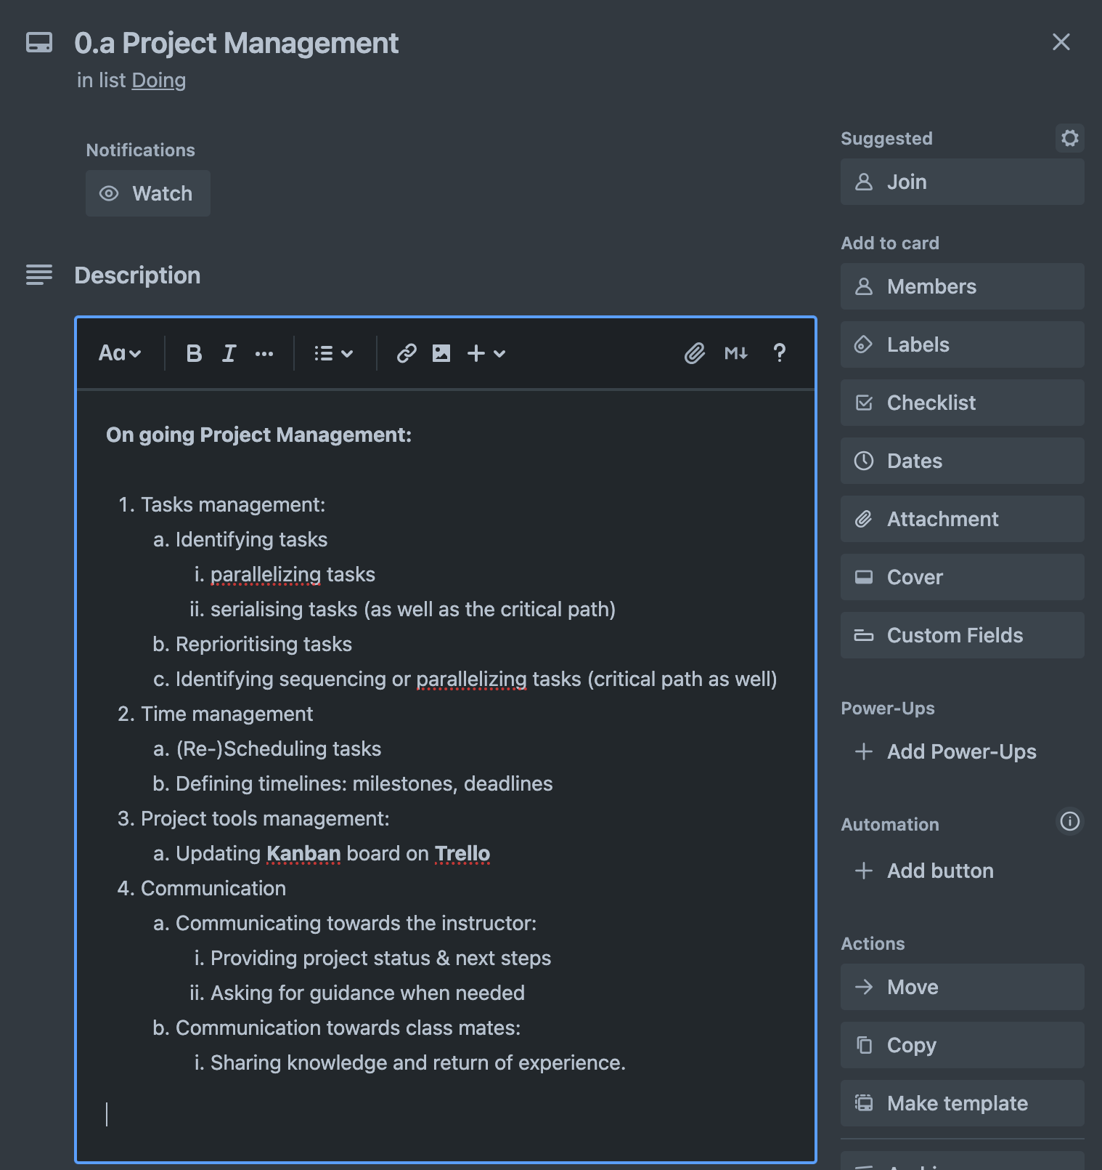


planning
Project Tools

Slide 9
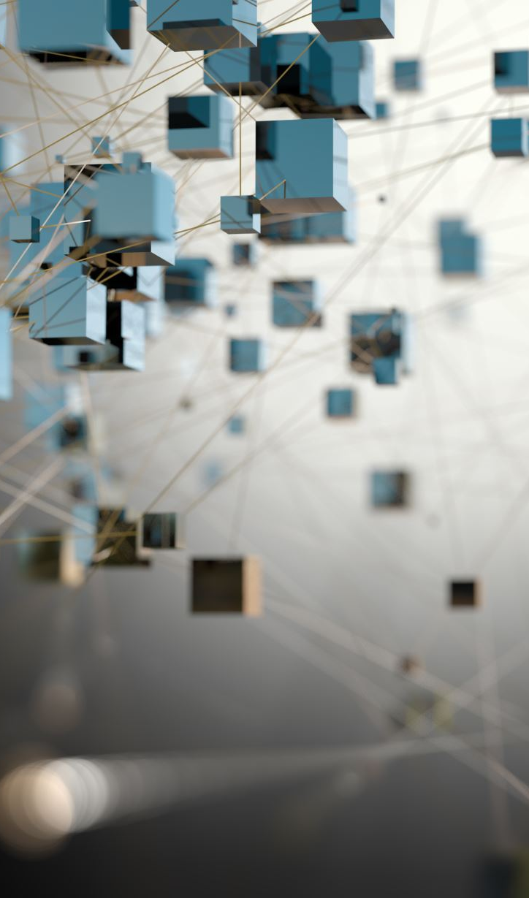
Data Gathering

Slide 10
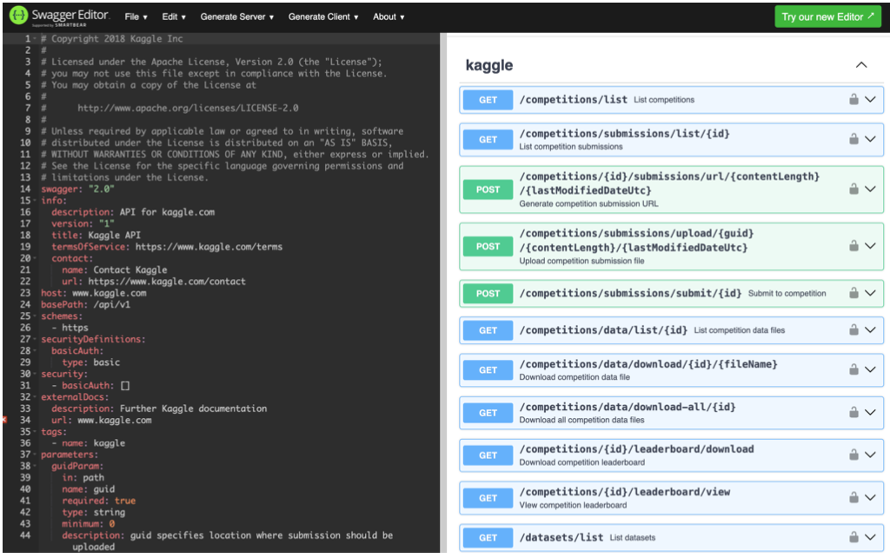
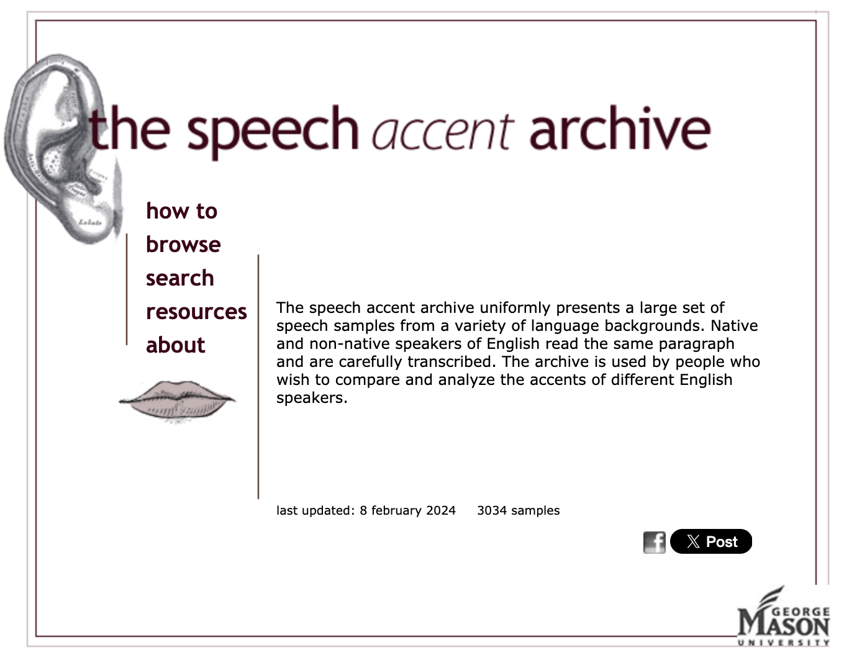
Kaggle – Speech Accent archive
Data gathered from Kaggle has been captured
through Kaggle’s API & Kaggle’s CLI.
Data gathered from speech accent archive
has been captured through web scraping .
https://editor.swagger.io/
https://accent.gmu.edu/

Slide 11
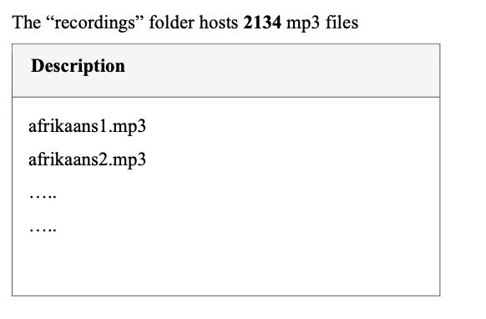

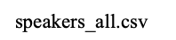
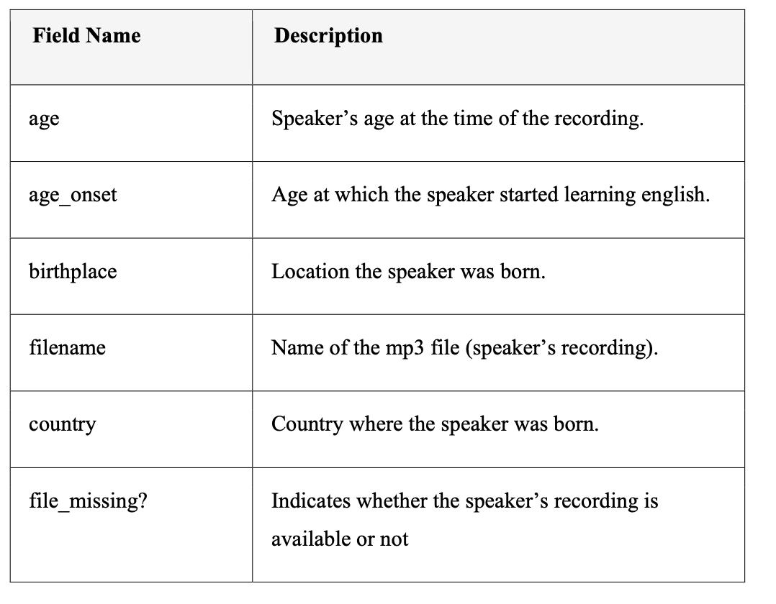
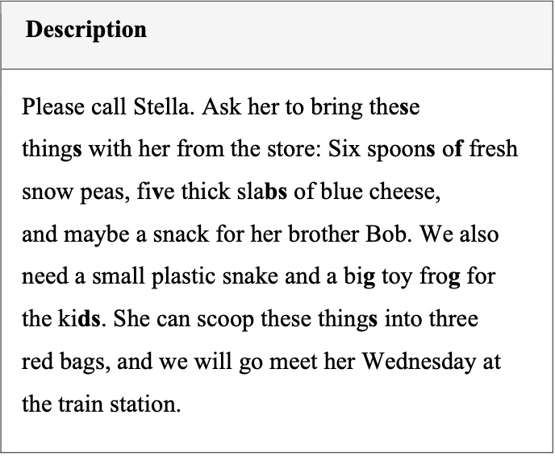
Data wrangling
Cleaning Column Names
Removing empty columns
Dealing with null values
Cleaning invalid values
Formating data types

Slide 12
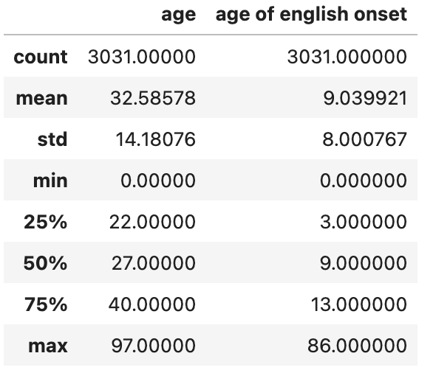

exploratory data analysis

Slide 13
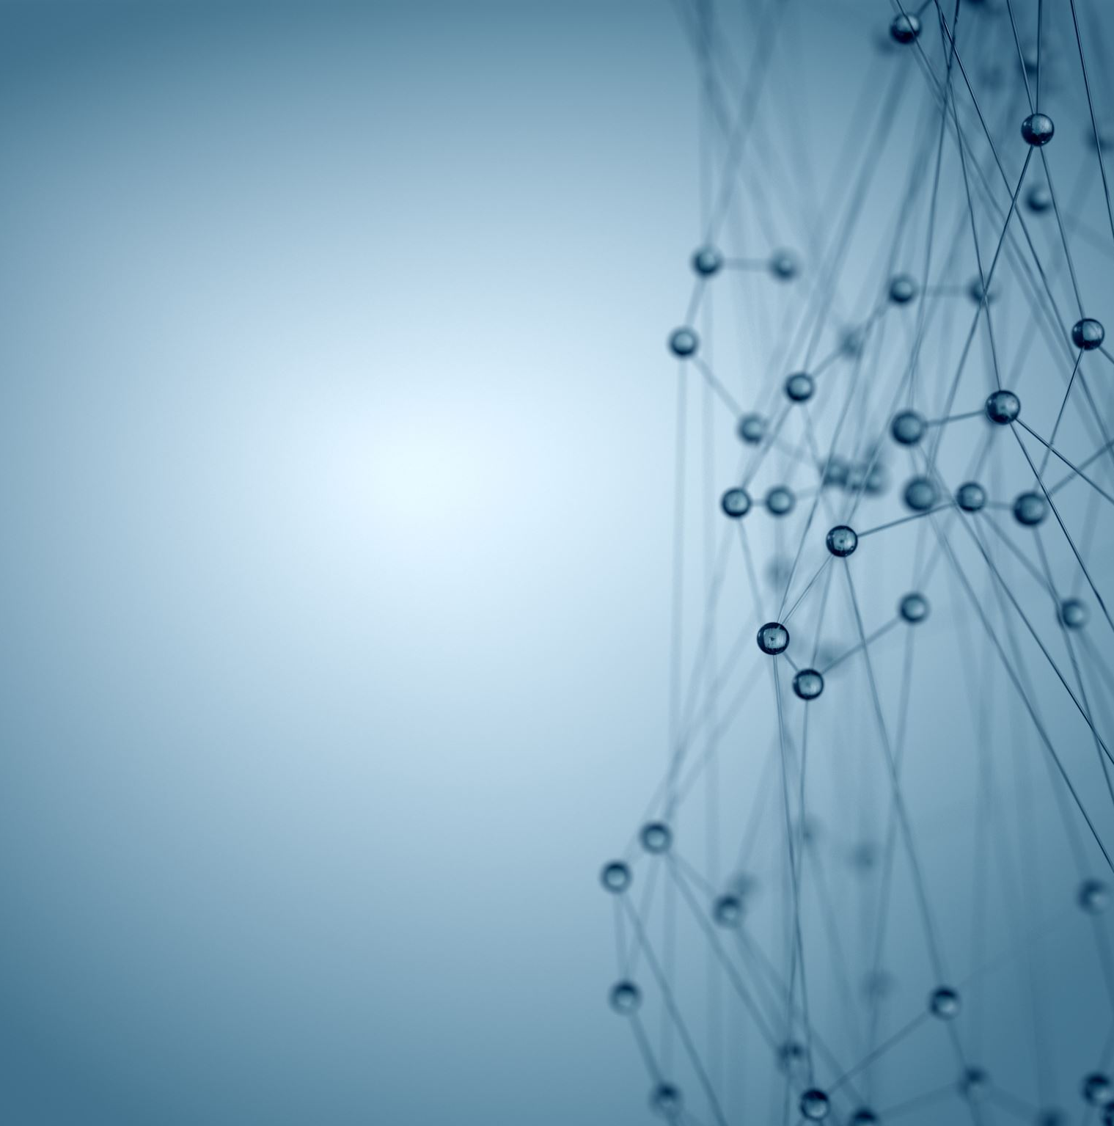
visualisation

Slide 14
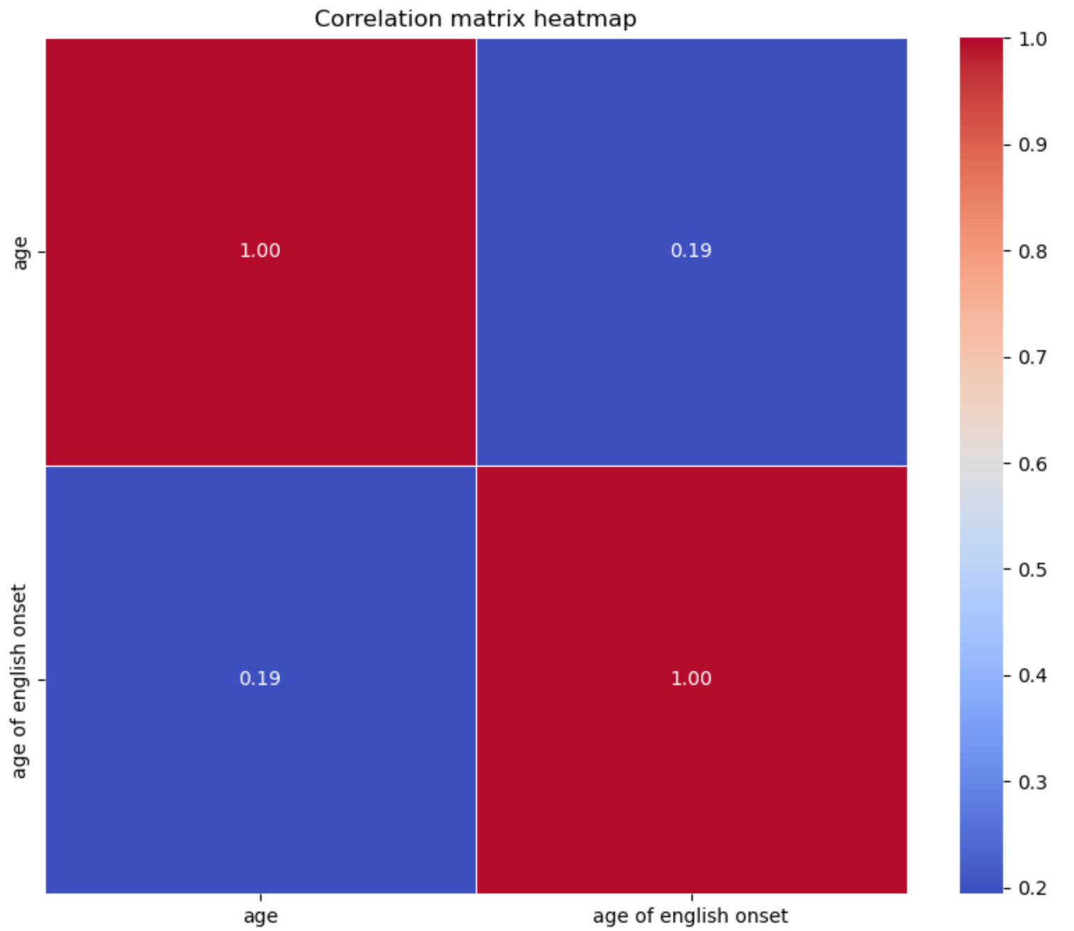

Slide 15

Databases

Slide 16
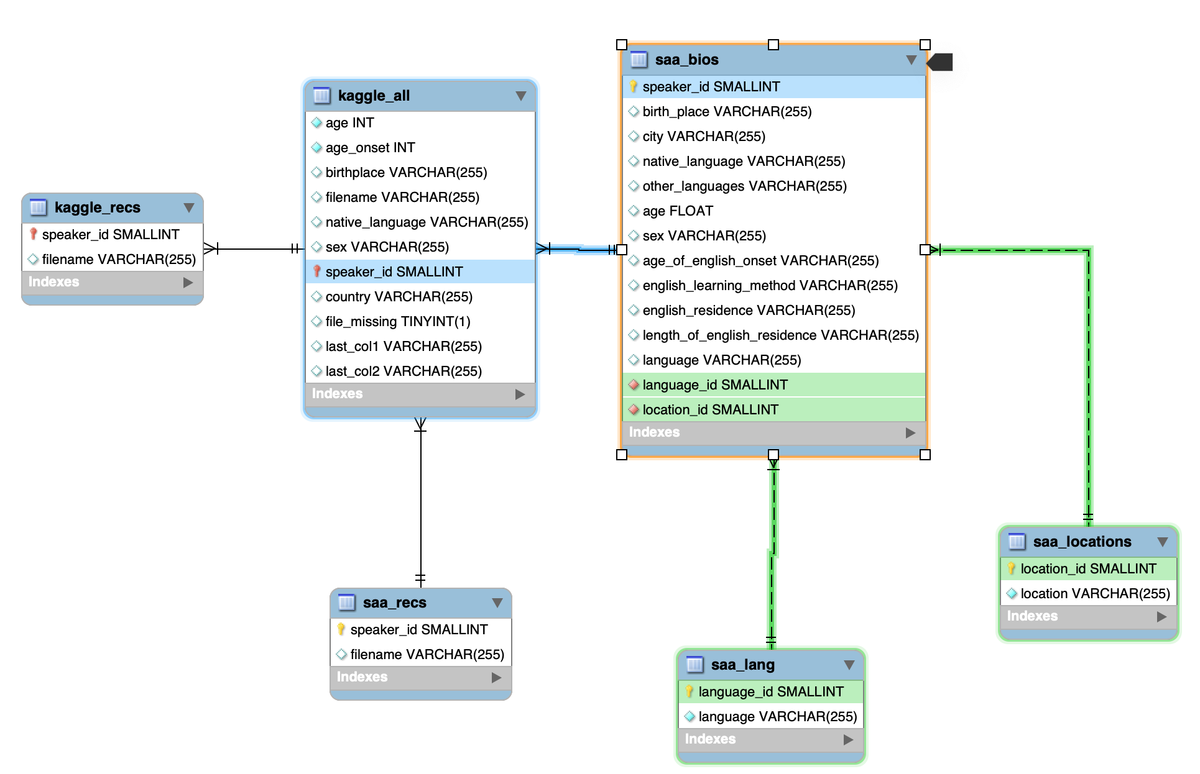
erd
ENTITY RELATIONSHIP DIAGRAM

Slide 17
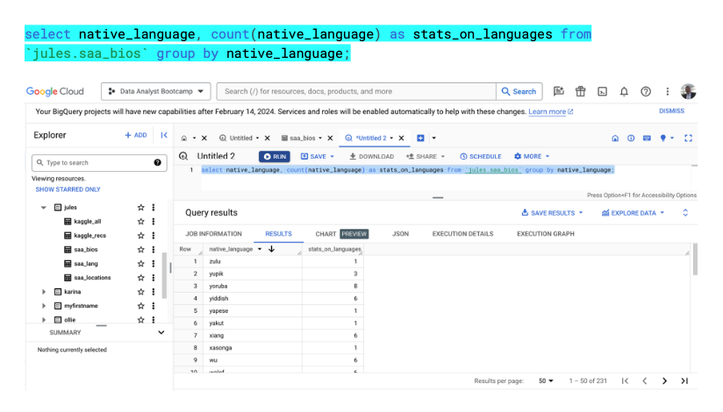
BIG Query

Slide 18
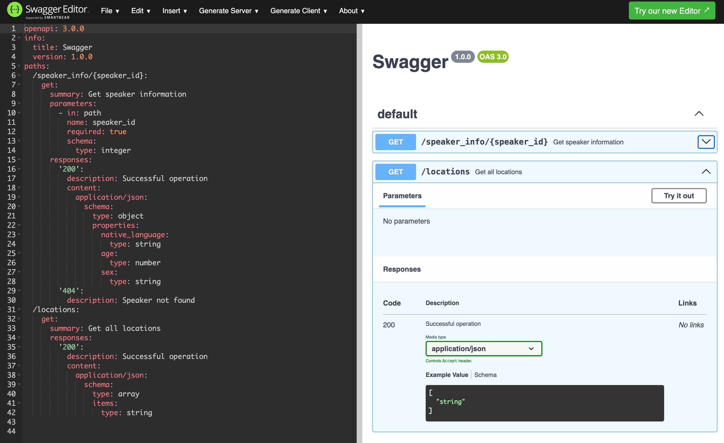
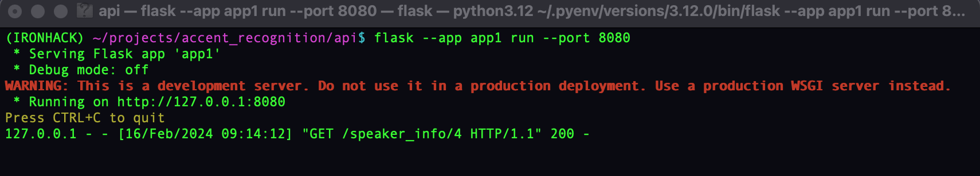
Api

Slide 19
Machine learning
Data Preprocessing:
Data Loading
Labeling
Truncating
Extracting Features
Mel-Frequency Cepstral Coefficients (MFCCs)
Data Splitting
Normalization
Selecting & training Models:
Convolutional Neural Networks (CNNs)
Recurrent Neural Networks (RNNs)

Slide 20

Data Preprocessing
Zooming on
Mel-Frequency Cepstral Coefficients (MFCCs)

Slide 21
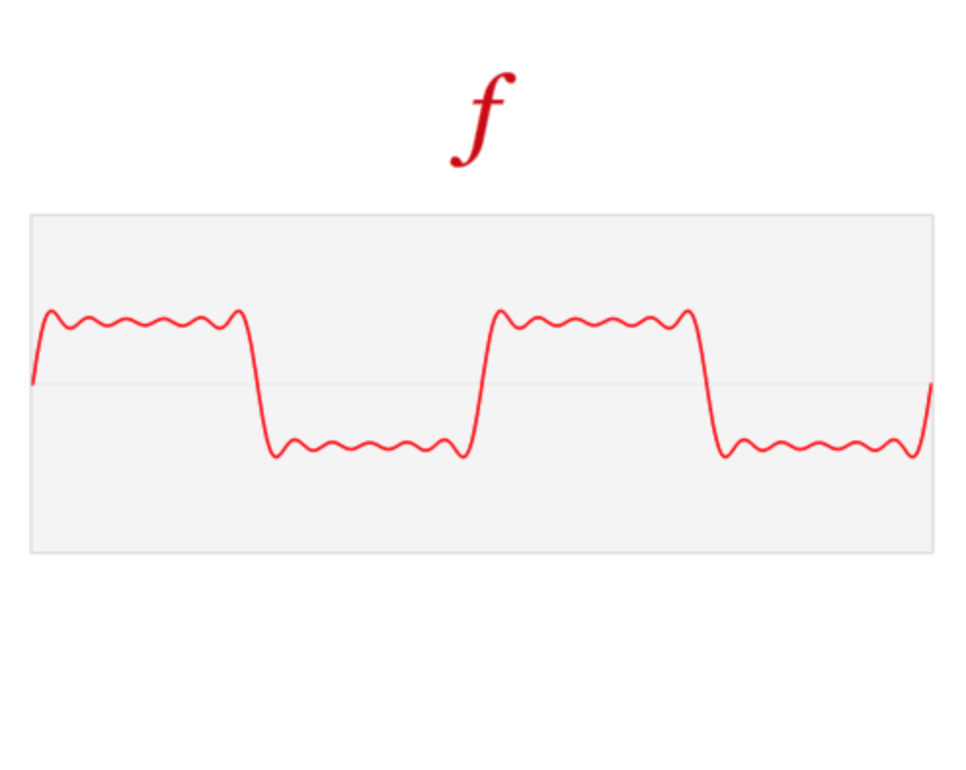
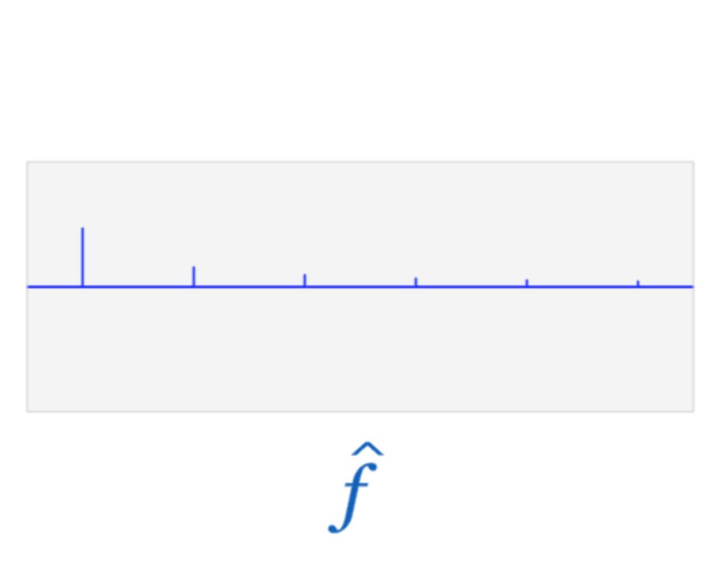
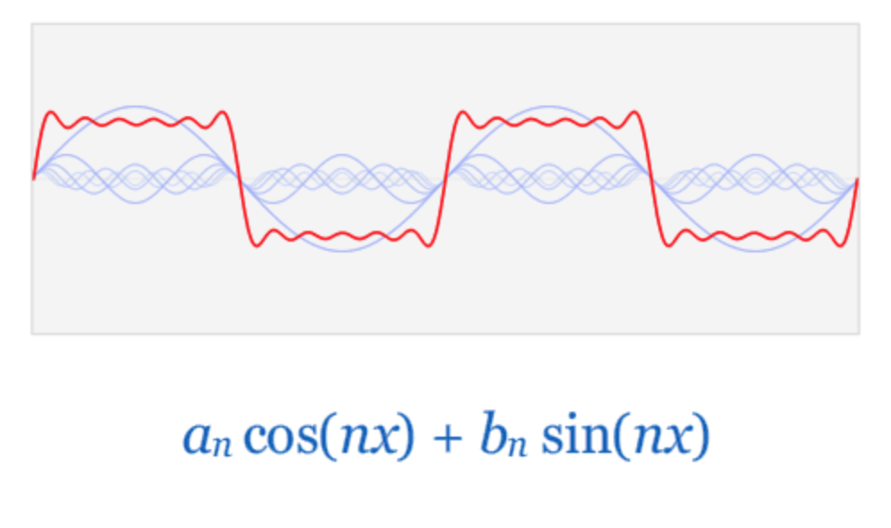
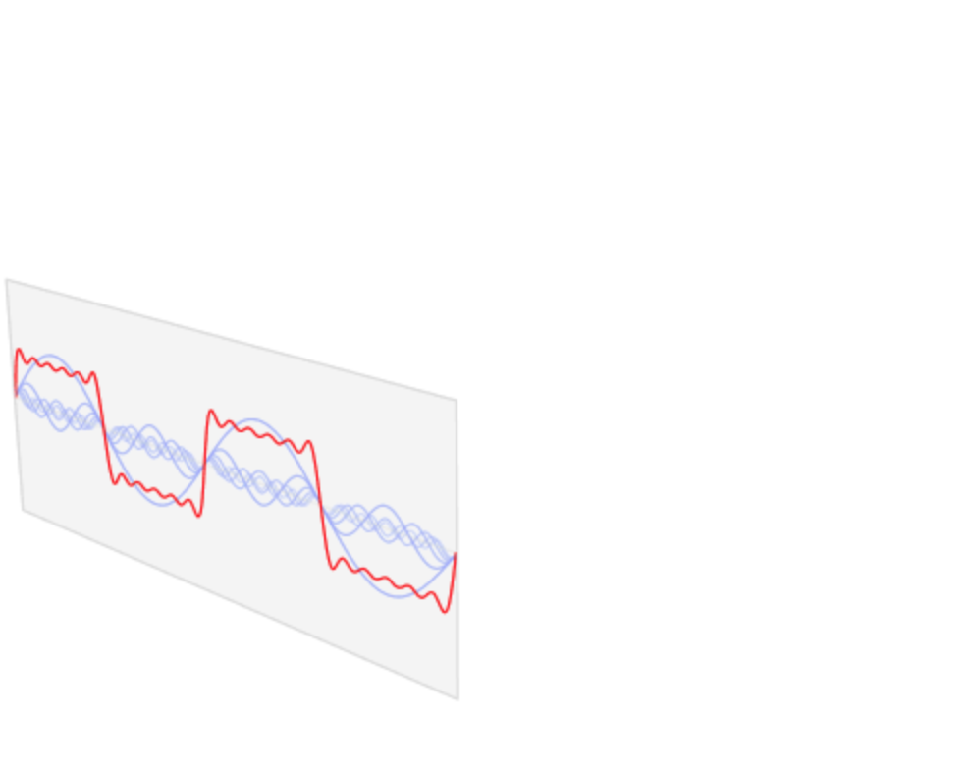
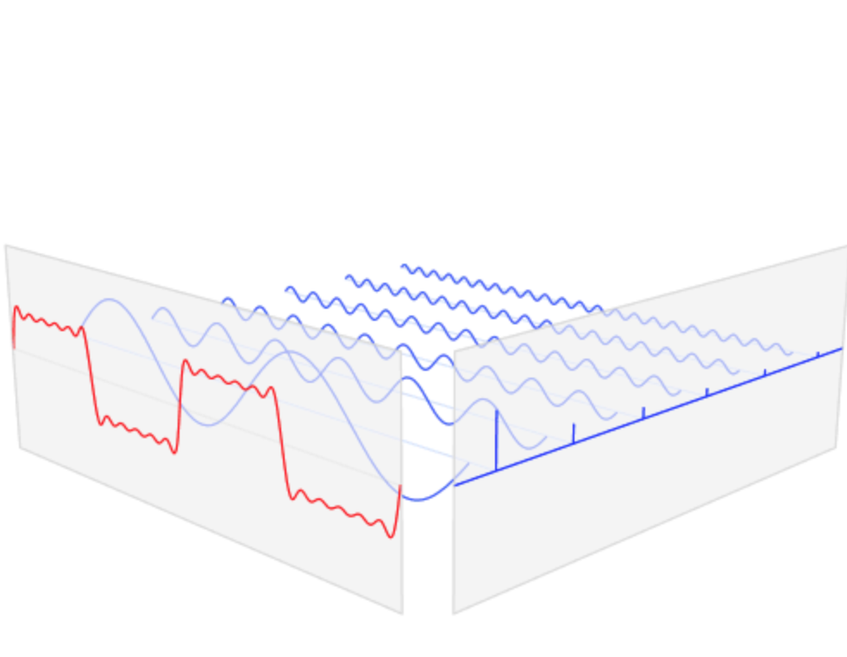
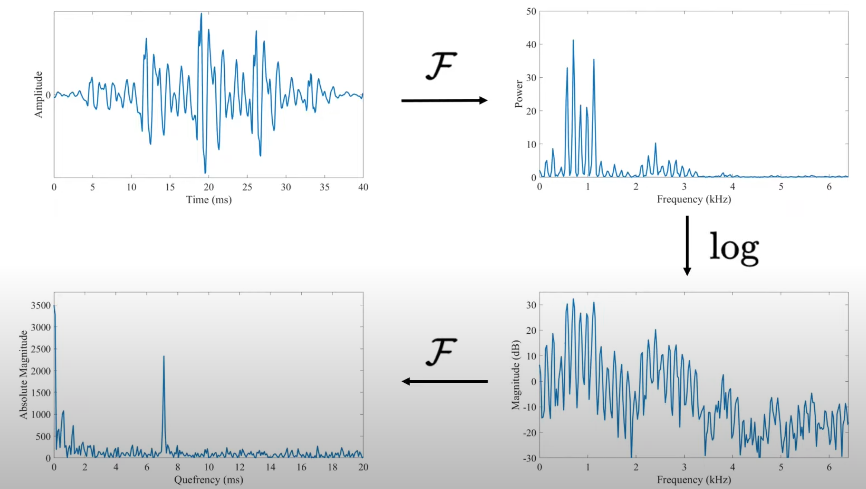
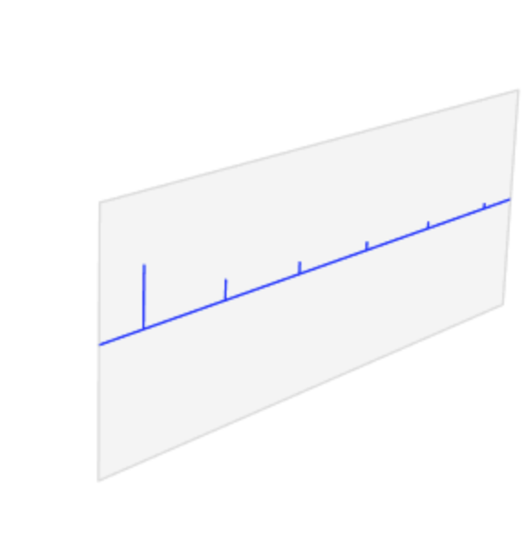
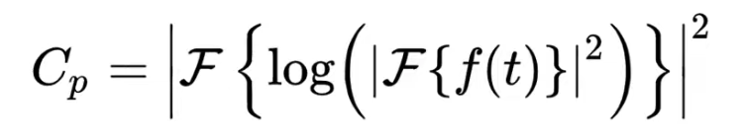
MFCC (Mel-Frequency Cepstrum Coefficients )
Cepstrum

Slide 22
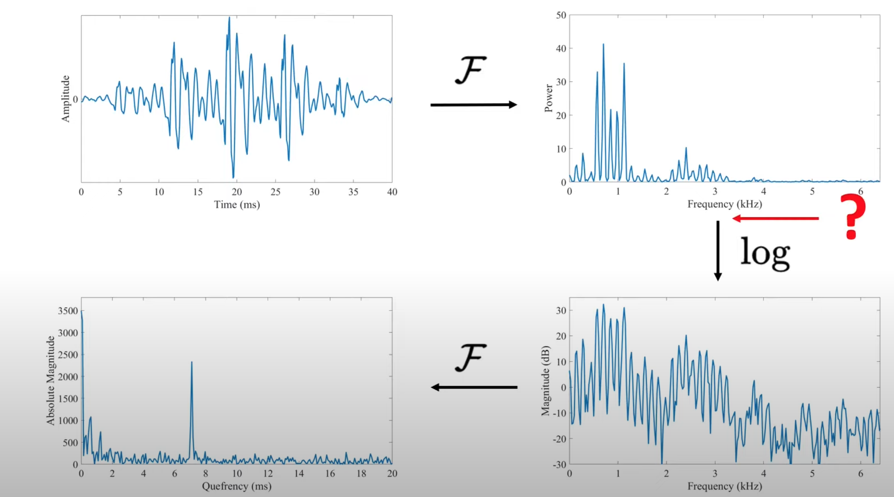
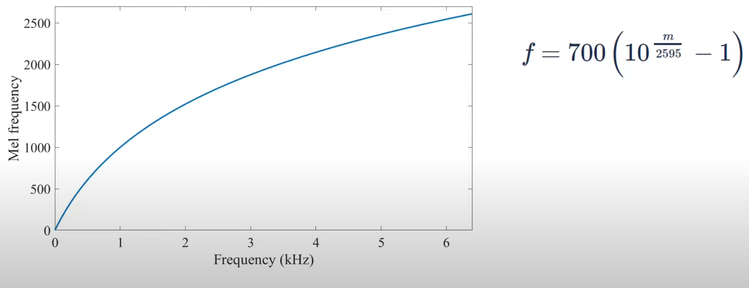
It’s not over … what about the MEL in MFCC ?
Mel Scale

Slide 23

Models comparisons
CNN vs RNN

Slide 24
CNN
CNNs are primarily used for image recognition and classification tasks.
Convolutional layers apply convolution operations to the input image, which helps in feature extraction by preserving spatial relationships.
CNNs are well-suited for tasks where the input has a grid-like topology, such as images, due to their ability to effectively capture spatial hierarchies of features

Slide 25
RNN
RNNs are designed to handle sequential data, such as time series data, natural language, and audio.
They have connections between neurons that form directed cycles, allowing them to exhibit temporal dynamic behavior.
RNNs suffer from the vanishing gradient problem, which can make it difficult for them to learn long-range dependencies in sequences.
Variants of RNNs, such as Long Short-Term Memory (LSTM) and Gated Recurrent Unit (GRU), have been developed to address the vanishing gradient problem and improve the learning of long-term dependencies.

Slide 26
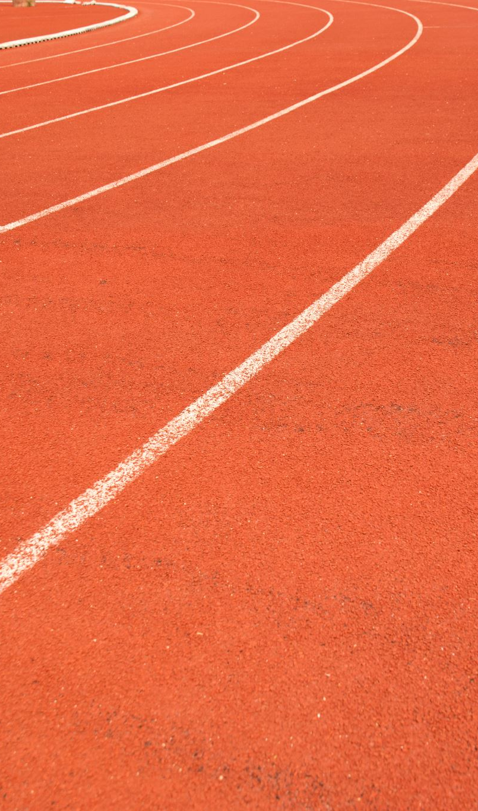
challenges
Time constraint !

